Slide 1
How the American Rescue Plan Helps American Families & Funds Our Future

Slide 2
The American Rescue Plan Act of 2021 Signed into law by President Biden on March 11, 2021
AFT President Randi Weingarten Says Biden’s American Rescue Plan Is
Once-in-a-Generation Investment in American People
WASHINGTON—American Federation of Teachers President Randi Weingarten issued the following statement after President Joe Biden signed the American Rescue Plan Act:
“This legislation will change lives almost immediately. It will send relief directly to the communities, schools, hospitals and workers that need it most, and help buoy the very institutions and people that have carried us through the COVID-19 crisis. After one of our country’s darkest hours, the American Rescue Plan shows us help is on the way: It invests in the testing and vaccination plans needed to reopen school buildings for safe in-person learning and provides necessary relief for small businesses as well as child care and healthcare assistance.
“But this is more than a COVID-19 relief bill; it aims to cut child poverty nearly in half, expand unemployment insurance, and bring unprecedented economic assistance to retirees, working people, older and younger Americans alike. This legislation is a down payment on the American spirit, and on our collective resiliency as we recover and rebuild.
“We thank President Joe Biden, Vice President Kamala Harris, Speaker Nancy Pelosi, Majority Leader Chuck Schumer and every single one of the Democratic members of Congress who voted for this bill—for having the imagination to go bold, the courage to go it alone, and the conviction to meet the needs of Americans at this moment.”
###

Slide 3
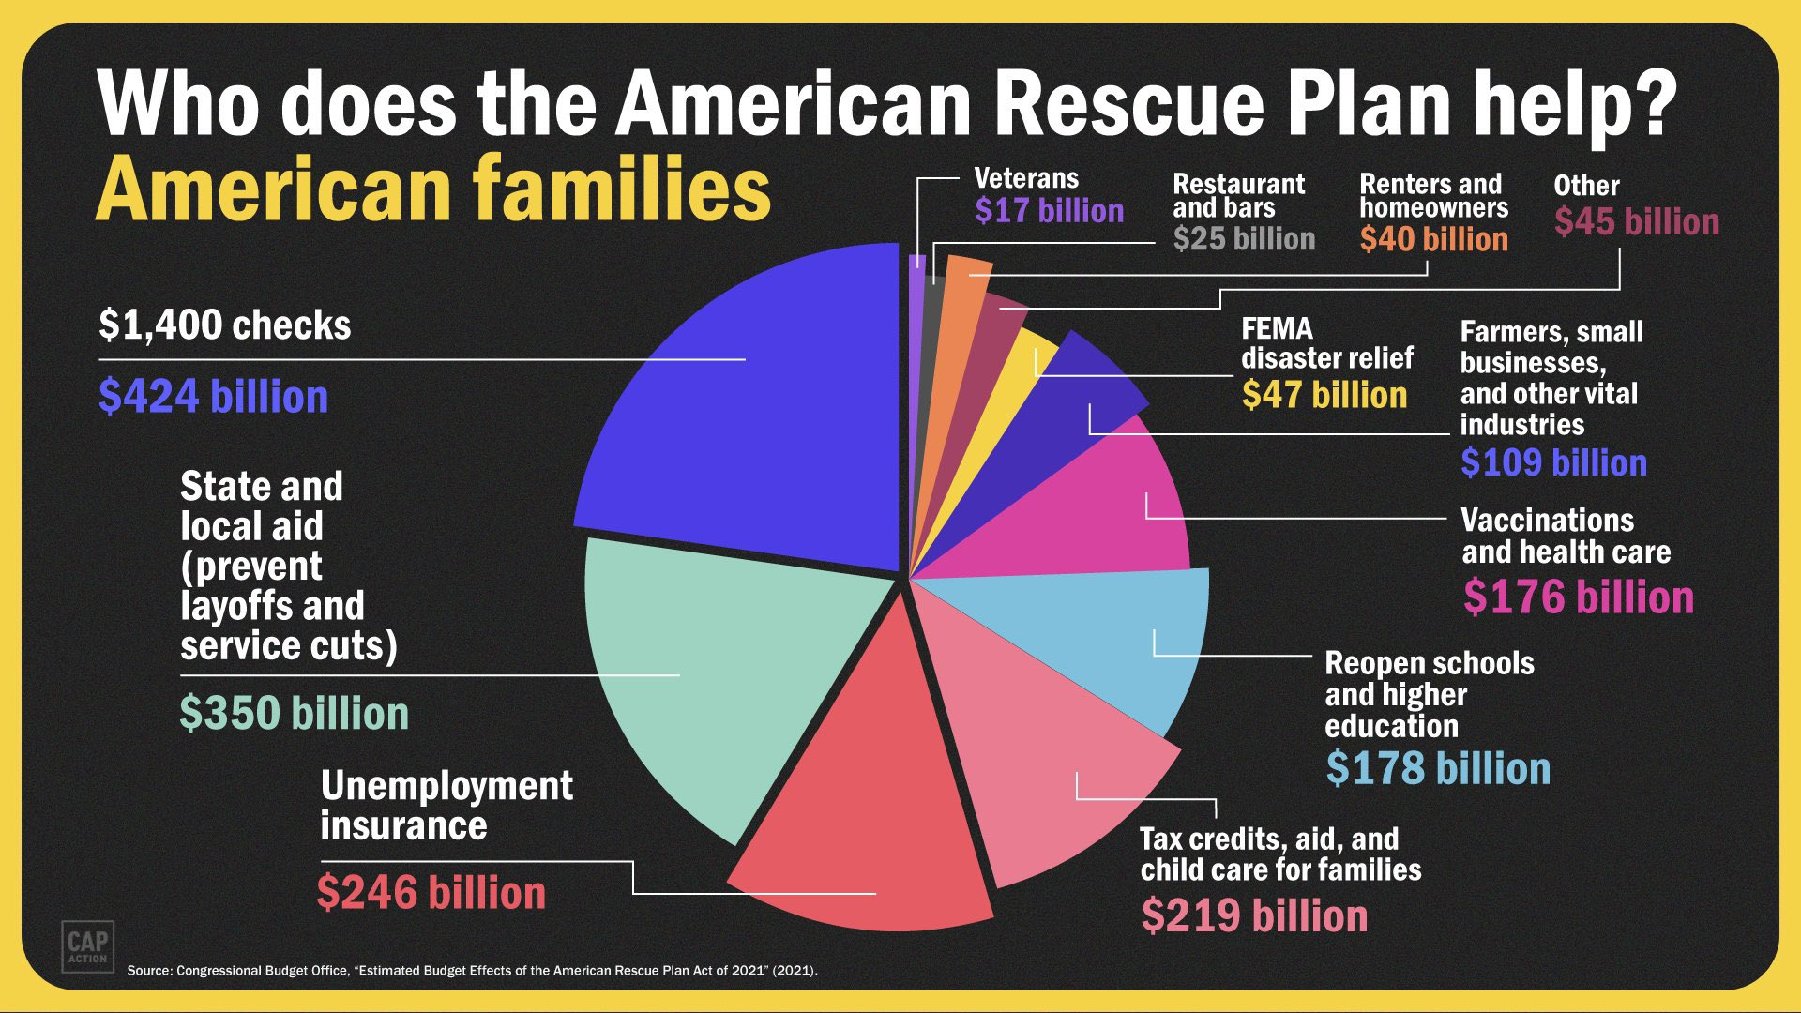

Slide 4
The American Rescue Plan Helps Schools, Students & Educators: $170 Billion for K-12 and Higher Education
Focus | Amount
K-12 Public Schools | $122.8
Private School set aside prohibits using the new money to support private school vouchers or other mechanisms for spending public money on private school | $2.75 billion
Higher Education | $40 billion
BIA and outlying areas | $1.7 billion

Slide 5
The Fine Print: K-12 The Elementary and Secondary School Emergency Relief Fund $122.7 billion, available through Sept. 30, 2023
The American Rescue Plan allocates funds to states/SEAs proportional to Title I grants, which then must distribute at least 90% of funds to school districts/LEAs. Funds to states must be spent within one year of receipt.
States are required to reserve at least:
5% for activities to address “learning loss,”
1% for evidence-based summer enrichment program, and
1% for “evidence-based comprehensive” afterschool programs.
School districts must reserve at least 20% to address “learning loss.”
Remaining funds to school districts are flexible and can be used for:
Repairing ventilation systems,
Reducing class sizes and implementing social distancing guidelines,
Purchasing personal protective equipment, and
Hiring support staff to care for students’ health and well-being.
School districts will be required to create and share plans publicly for returning to in-person instruction within 30 days.

Slide 6
The Fine Print: K-12 What Else Is In It?
The American Rescue Plan also includes:
Additional IDEA funding for FY 21, including grants to states, preschool grants and programs for infants and toddlers. $3.03 billion
Identifying and providing children & youth experiencing homelessness with wrap-around services and assistance to attend and fully participate in school activities. $800 million
Funding for the Emergency Assistance to Non-Public Schools Program for governors to provide services or assistance to non-public schools that enroll a significant percentage of low-income students. $2.75 billion
Targeted aid for Bureau of Indian Education-operated and funded K-12 schools and Tribal Colleges or Universities. $850 million
Creates an Emergency Connectivity Fund that benefits rural communities by reimbursing schools and libraries for wi-fi hotspots, modems, routers, devices that combine a modem and router, and connected devices. $7.17 billion

Slide 7
The Fine Print: K-12 and Higher Ed Maintenance of Effort. Maintenance of Equity.
Maintenance of Effort (MOE):
States must maintain spending on both K-12 and higher education in FY 2022 and FY 2023 at least at the proportional levels relative to a state’s overall spending. The MOE can be waived by the Secretary of Education.
Maintenance of Equity (States):
States cannot cut per-pupil spending for “high-need” LEAs at a rate steeper than overall cuts in per-pupil spending across all local education agencies. States cannot fund “highest poverty” LEAs below their FY 2019 funding.
Maintenance of Equity (School Districts/LEAs):
LEAs cannot cut per-pupil spending or staffing for any high-poverty school at a rate steeper than overall cuts in per-pupil spending across all schools served by the LEA. Exempts districts serving <1,000 students, operating a single school or serving all students in single grade span in one school or those granted a waiver.
Maintenance of Equity (Higher Education):
Makes changes to the federal 90/10 rule, which prohibits for-profit colleges from receiving more than 90% of their revenue from federal aid programs. Regulations would not take effect until January 2023.

Slide 8
The Bottom Line: K-12 How American Rescue Plan K-12 Funds Can Be Spent
Anything already allowed under Every Student Succeeds Act (ESSA) and/or the Individuals with Disabilities Education Act (IDEA).
Expenditures that let school districts continue operations and retain existing staff.
Programs or activities directed for low-income children or students, children with disabilities, English learners, racial and ethnic minorities, students experiencing homelessness, and foster care youth, including community schools.
Supplies for cleaning school buildings.
Technology to support remote instruction.
Mental health services.
Summer or after-school programs.
Efforts to address “learning loss.”
School building upgrades and repairs for reducing COVID transmission, including improving ventilation.

Slide 9
The Fine Print: Higher Education $40 billion, available through Sept. 30, 2023
The American Rescue Plan provides $40 billion through existing Higher Education Emergency Relief (HEER) Fund, including funding for:
Public and private non-profit institutions $36 billion
Historically Black colleges and universities, tribal colleges and minority-serving institutions $3 billion
For-profit colleges to provide financial aid grants to students $400 million
Institutions with the greatest unmet need related to the pandemic or those not served by the HEER formula $200 million
Institutions must spend at least 50 percent on emergency financial aid grants provided directly to students.
Institutions can use remaining funds to replace lost revenue, reimburse for emergency expenses, and more.
Maintenance of Effort and Maintenance of Equity requirements apply through FY 2023. Changes to the 90/10 rule would take effect January 2023.

Slide 10
The Fine Print: State & Local Aid $350 billion, available through Dec. 31, 2024
Provides $350 billion to help states, cities, towns and tribal governments cover increased expenditures, replenish lost revenue and mitigate economic harm from the COVID-19 pandemic. Funds may be used to:
Respond to the COVID-19 emergency and address its economic effects, including through aid to households, small businesses, nonprofits, and industries such as tourism and hospitality.
Provide government services affected by a revenue reduction resulting from COVID-19.
Make investments in water, sewer and broadband infrastructure.
Provide "premium pay" to essential workers of up to $13 per hour, capped at a maximum $25,000.
State and local governments cannot use the funds towards pensions or to offset revenue resulting from a tax cut enacted since March 3, 2021.
State and local governments can transfer funds to private nonprofit groups, public benefit corporations involved in passenger or cargo transportation, and special-purpose units of state or local governments.

Slide 11
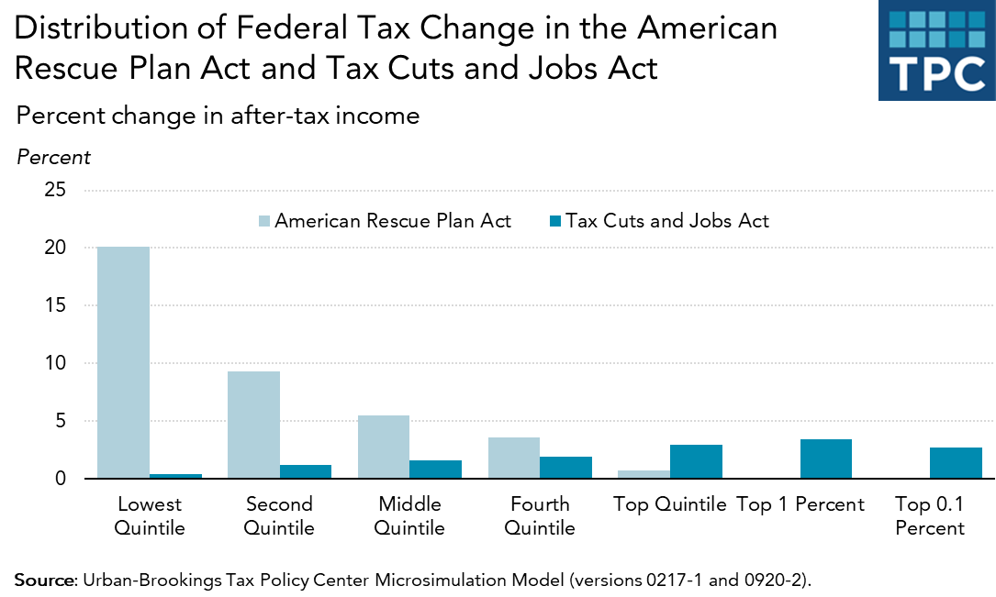
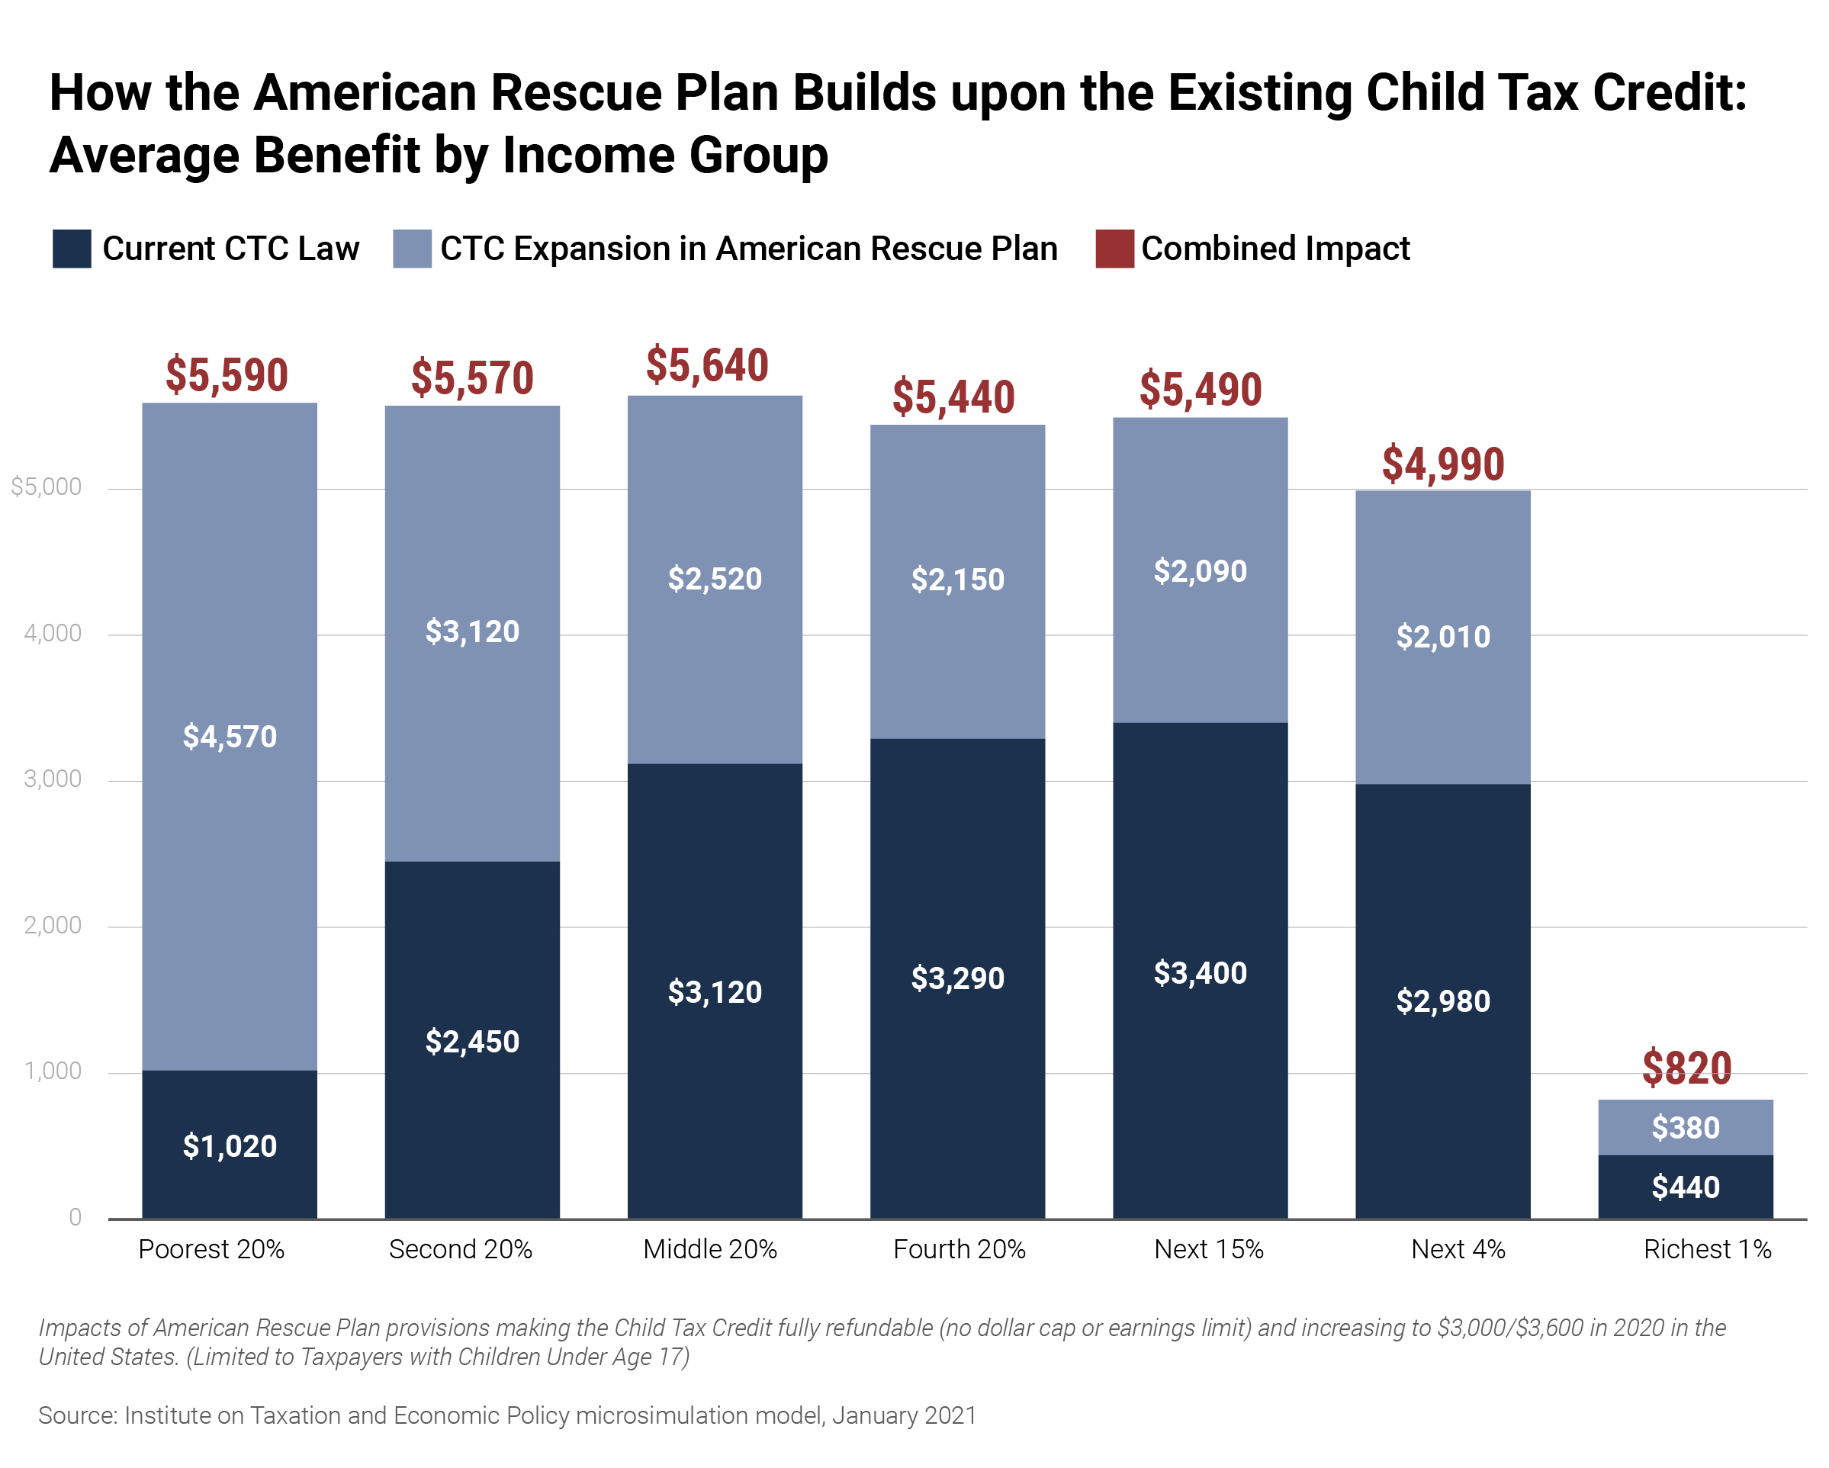
The Fine Print: Direct Relief for American Families
The American Rescue Plan Helps Hurting Families:
Helping those at risk of losing their homes by extending the moratorium on evictions and foreclosures to Sept 30 and providing legal support and $5 billon in emergency assistance for the homeless.
Helping feed hungry families by extending SNAP and the Pandemic EBT and other agriculture and nutrition programs.
Helping families pay household bills with:
$25B for rental assistance, on top of the $25B from the Consolidated Appropriations Act
$5B to assist with water, electricity and utility expenses through programs like Low Income Home Energy Assistance Program
Helping shore up child care with:
$15 billion for Child Care Development Block Grants
$24 billion for providers
$35 million for administration costs
$1 billion for Head Start
Putting money in people’s pockets with $1400 stimulus check for most Americans, expanded to include adult dependents and mixed status households.
Strengthening services with $3.88 billion investment for people struggling with mental health and substance-abuse.
Helping rural communities with targeted aid for unique rural health, education, agriculture and infrastructure needs.
Helping workers with $1 billion for workforce development.
Directing immediate aid and benefits for small businesses owners, restaurants and live venues, health care workers, transportation workers, federal employees, veterans, and other hard hit populations.
Notes:
Sources:
“President-elect Biden Announces American Rescue Plan,” Biden-Harris Transition Team, January 19, 2021, https://buildbackbetter.gov/wp-content/uploads/2021/01/COVID_Relief-Package-Fact-Sheet.pdf
“Household Pulse Survey,” US Census Bureau, January 19, 2020, https://www.census.gov/data-tools/demo/hhp/#/?measures=HIR&s_state=
“Tracking the COVID-19 Recession’s Effects on Food, Housing, and Employment Hardships,” Center on Budget and Policy Priorities, Accessed February 23, 2021, https://www.cbpp.org/research/poverty-and-inequality/tracking-the-covid-19-recessions-effects-on-food-housing-and

Slide 12
The Fine Print: Defeating COVID-19
The American Rescue Plan will immediate bolster our national fight against the COVID pandemic. It includes:
$7.5 billion for Health and Human Services and the Centers for Disease Control to promote, distribute and monitor vaccines.
$1 billion for the CDC for vaccine awareness and engagement activities.
$600 million for the Indian Health Service’s vaccine-related efforts.
$500 million for the Community Facility Program to help rural hospitals and local communities broaden access to COVID-19 vaccines & food assistance.
$500 million for the Food and Drug Administration to aid in activities such as development and surveillance of vaccines and therapeutics.
100% reimbursement to states for Medicaid recipients to get the vaccine for free.
$50 billion to expand COVID-19 testing through efforts such as implementing a national testing strategy for contact tracing, surveillance and mitigation.
$500 million for CDC tracking of COVID-19 hot spots and emerging variants.
permitted (such as obtaining a vaccination).

Slide 13
The Fine Print: Healthcare, COBRA and Paid Sick & Family Leave
The American Rescue Plan will also help defeat the pandemic by strengthening our healthcare infrastructure and investing in the health and wellbeing of healthcare providers and the nation. It will:
Lower ACA health insurance premiums for millions of Americans.
Cover 100% of COBRA subsidies for those who’ve lost employer-sponsored coverage
$140 million to support mental health and wellbeing of healthcare professionals.
$24 billion for Community Health Centers, rural healthcare providers and a public health workforce.
Increase vaccine distribution capacity, provide medical supplies and medical surge capacity, expand access to telehealth, and help to fill the gap for rural healthcare providers.
Unfortunately, this does not make permanent paid sick and family leave benefits created in the Families First Coronavirus Response Act of 2020.
It provides payroll tax credits for employers who voluntarily provide paid leave through the end of September 2021.
It expands eligibility to state and local governments that provide this benefit.
It expands the reasons for which reimbursed leave is permitted, such as obtaining a vaccination.

Slide 14
The Fine Print: Even More Ways to Help the Country
Enhanced Worker Protections $200 million Additional funding for the Department of Labor to bolster worker protection enforcement activities through the Wage and Hour Division, the Office of Workers’ Compensation Programs, the Office of the Solicitor, the Mine Safety and Health Administration, the Occupational Safety and Health Administration, and the Office of Inspector General.
Community Navigator Program for Underserved Businesses $100 million Designated funding for community organizations and community financial institutions with a focus on and experience working in minority, immigrant, and rural communities to serve as community navigators. Navigators help connect small business owners in these communities to critical resources, including small business loans, business licenses, and federal, state and local business assistance programs.
Expansion of Paycheck Protection Program Eligibility $7 billion PPP loans are now available any 501(c) organization that is exempt from taxation including not-for-profit labor and other not-for-profit organizations which are conducted as active businesses and meet the requirements. Eligibility is restricted to unions with fewer than 300 employees and whose lobbying activities amount to less than 15 percent of the total activities. Other restrictions apply.

Slide 15
The Fine Print: Additional Resources
The White House:
The American Rescue Plan (Homepage)
The American Rescue Plan Has Passed. Now What? (Blog) President Biden’s Speech on the One Year Anniversary of the Pandemic (YouTube)
Senate Democrats:
American Rescue Plan Resources & Materials (Homepage)
Title-by-Title Summary of the American Rescue Plan (White Paper)
Center for American Progress:
American Rescue Plan Could Help Prevent State Public Higher Education Cuts (Report)
Center for Budget and Policy Priorities:
American Rescue Plan Act Will Help Millions and Bolster the Economy (Report)
Please remember to thank your Representatives and Senators for voting YES

